Slide 1
Avian Task Group
Bob Cordie
Biologist
The Dalles Lock and Dam
Jan, 2018

Slide 2
Catalyst for this TG
Inland Avian Predation Work Group
  USGS, OSU and RTR survey nest colonies. PIT and population
  PIT measured from McNary. PIT trend not available.
  2015 consumption estimate 7.4% SR sockeye, 9.7% SR steelhead,13.2% UCR steelhead (8.3-21.1)
  2016 consumption listed species estimate 6.4% SR sockeye, 6.7% SR steelhead and 10.1% UCR steelhead
  RTR report recommends managing Miller gulls to achieve IAPMP goal
  “Predation rates by Miller rocks gulls were particularly alarming”
  Inland Avian Work Group wrapping up in 2018

Slide 3
New Direction
Miller Island gull colony remains TD/JD concern
Inland Avian Work Group disbanding 2018
Refocus to on site avian abatement improvement options
Include all projects to share ideas
Compare available tools
  Hazing – limited effectiveness
  Avian lines – limited effectiveness
  Lethal removal – NWW only

Slide 4
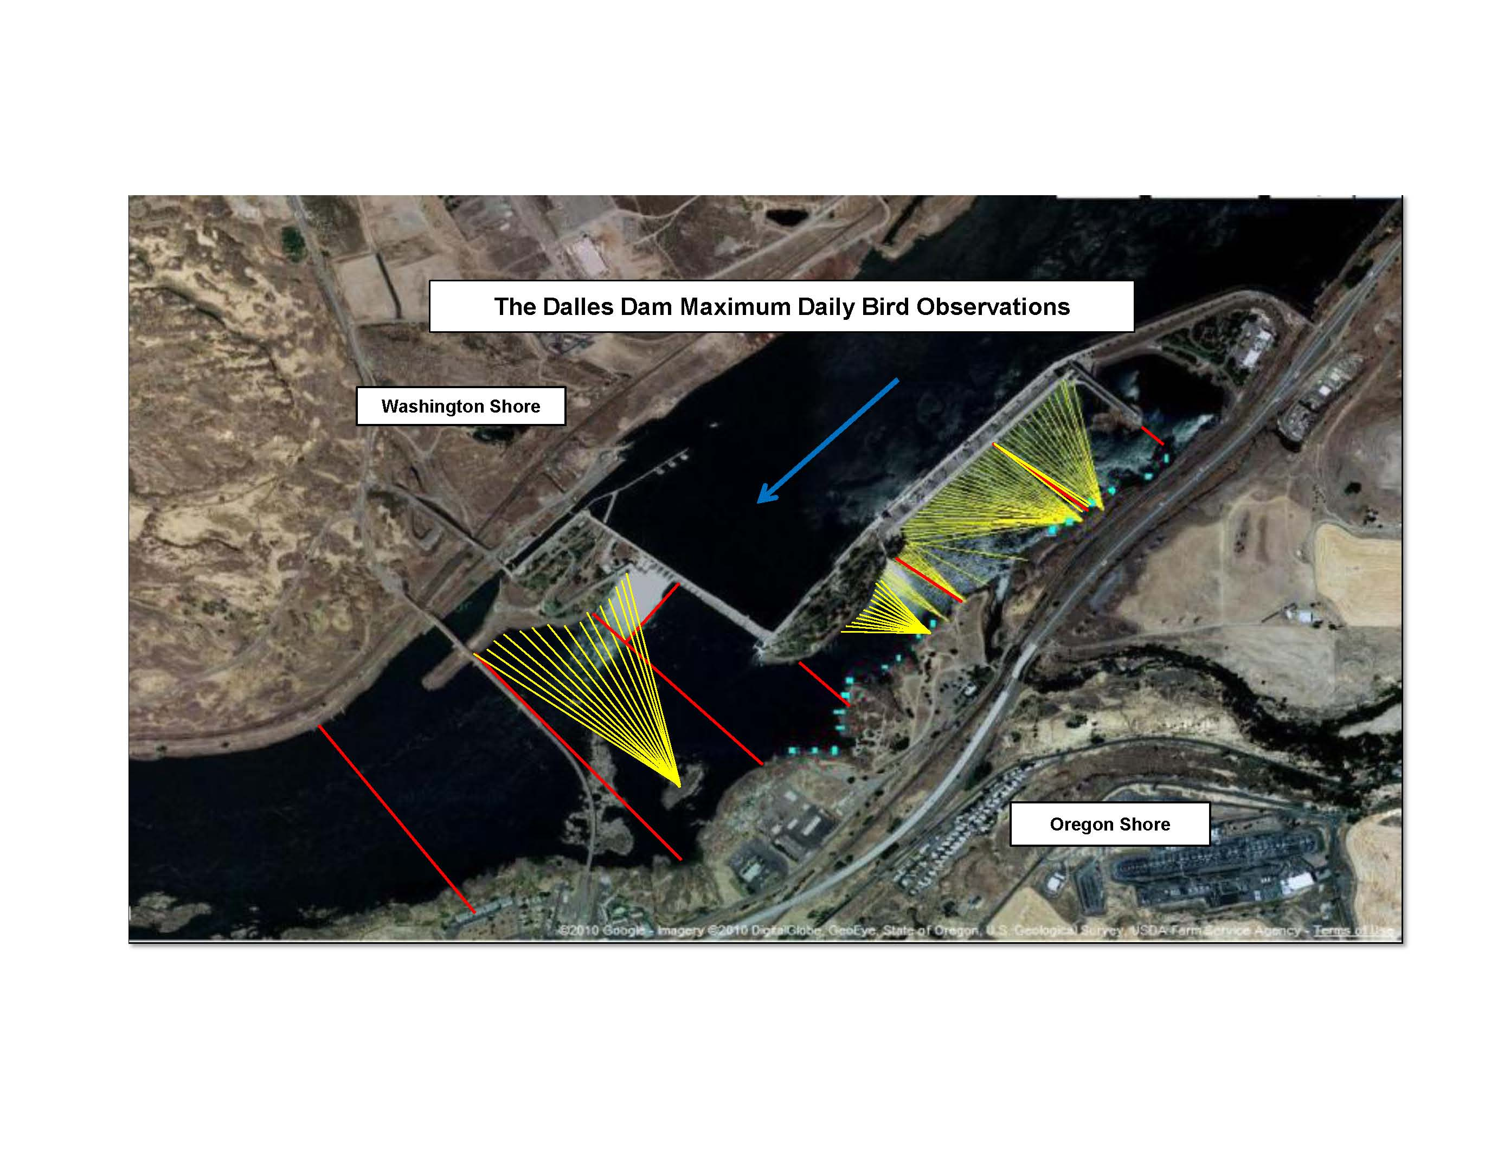
The Dalles Avian Lines
Notes:
RPA detterent. Present grid. Best detterent to date. Challenges; falcon listing/bridge attachment/falcon nest/BRZ only.. Note westrick, sluiceway and powerhouse…

Slide 5
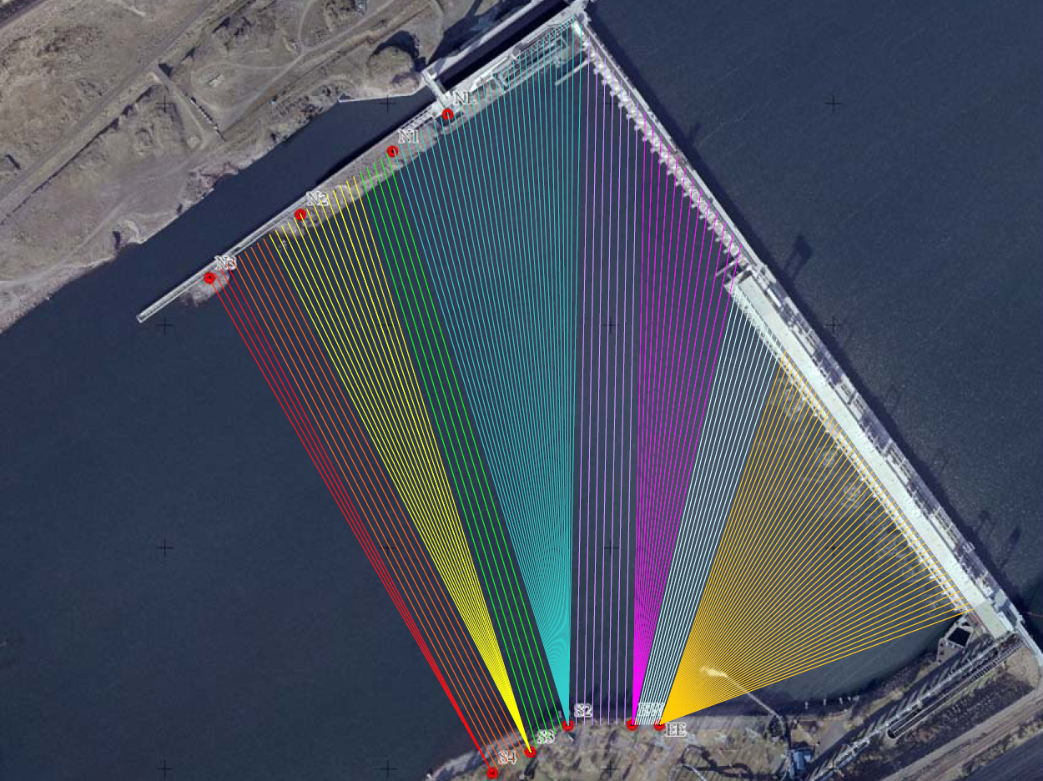
John Day Avian Lines
Notes:
Status report page. Conflicting interest. Lines for gulls not eagles. Red grids/yellow lines. Braided stainless wire. Focus westrick lines. Lamprey protection.

Slide 6
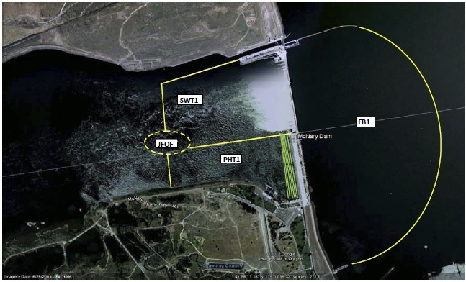
McNary Dam Avian Lines/zones
Perching deterrents:
Bird spike strips along outfall pipe and barge dock:
Avalarms/“Hawks” along barge dock, navlock wingwall, north trash sluiceway
and along outfall:

Slide 7
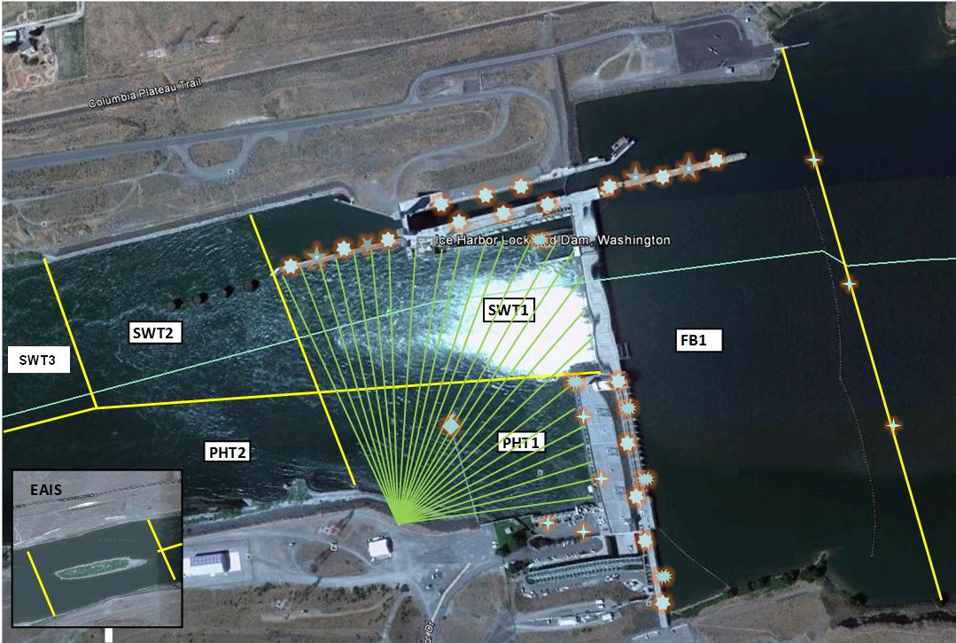
Ice Harbor Dam Avian Lines/zones
Wire strung over nav. lock guide wall handrail:
Spider wire/ spike strips on light poles and forebay buoys
Water cannon at end of outfall pipe:
Propane cannons-powerhouse intake deck and adjacent to spillway:
27 avian wires spanning the tailrace:

Slide 8
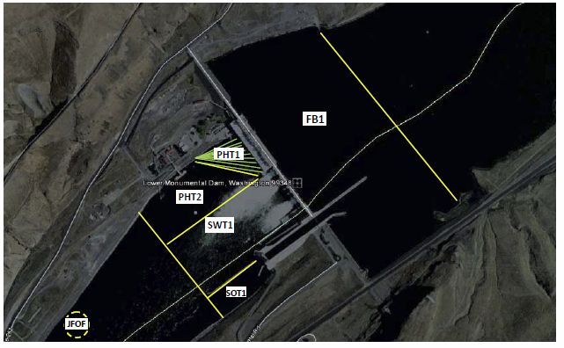
Lower Monumental Dam Avian Lines/Zones
Hydro cannons at end of new fish bypass outfall pipe:
Propane cannon station:
Wire strung over navlock wingwall handrail:
Spikes installed on wingwall deck and outfall pipe:

Slide 9
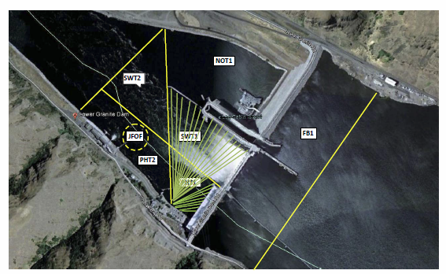
Lower Granite Dam Avian Lines/zones
Wires above navlock wingwall handrails:
Row of spike wires on guide wall deck:
Spider wires on top of guide wall light poles and forebay buoys:
34 avian wires spanning the tailrace

Slide 10
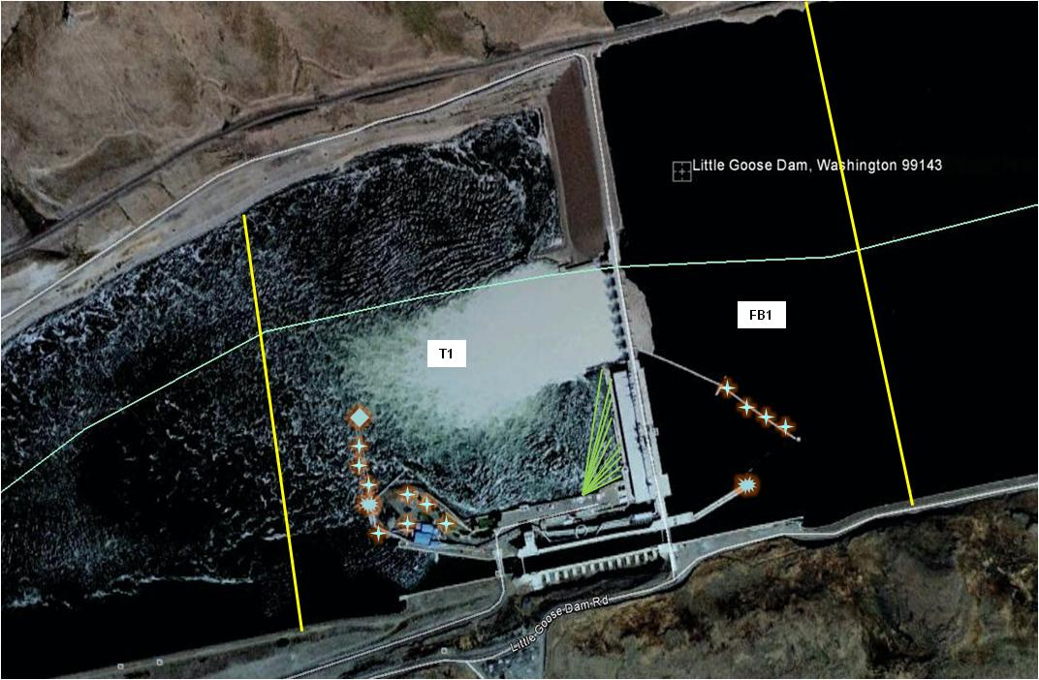
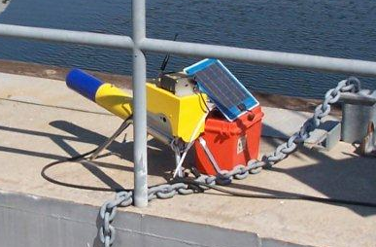
Little Goose Dam Avian Lines/zones
Propane Cannon
Spike strips on outfall pipe, light poles, trash/shear boom:
Water cannon at end of outfall pipe:
Propane cannon at base of outfall pipe:
12 avian wires across powerhouse tailrace:

Slide 11
Dam Comparisons
Dam | Hazing Dates | Hazing Type | Hazing hours/day | COE haze
Bonneville | Apr 1 - July 31 | Shore | 12hr Apr - Jul | N
The Dalles | Apr 15 - Jul 31 | Boat/shore | 16hr Apr/May/Jun, 14 Jul | N
John Day | Apr 15 - Jul 31 | Boat | 8hr Apr-Jul | N
McNary | Apr 16 - Jul 29 | Boat/shore | 8hr Apr, 16hr May/Jun, 8hr Jul | N
Ice Harbor | Apr 1 - Jun 30 | Boat/shore | 8hr Apr, 16hr May, 8hr Jun | Y
Lower Mon | Apr 1 - Jun 2 (Jul 1 if needed) | Shore | 8hr Apr, 16hr May, 8hr Jun | Y
Little Goose | Apr 3 - Jun 25 | Boat/shore | 8hr Apr, 16hr May/Jun | N
Lower Gran | Apr 1 - Jun 30 | Shore | 8hr Apr, 16hr May, 8hr Jun | Y
Dam | Avian Lines | Toolbox | Lethal | Trigger for Increased Action
Bonneville | Yes/wire | water cannon, propane | N | 150 single zone non-lethal
The Dalles | Yes/wire | none | N | 250 but no actions available
John Day | Yes/rope/high OM | none | N | N/A
McNary | Yes/wire | alarm, water cannon | Y | 100-200 total - lethal
Ice Harbor | Yes/wire | laser,spikes,water cannon | Y | 2-3x avg, hazing not work - lethal
Lower Mon | Yes/wire | spikes, water cannon | Y | 86 gull/43 tern/15 corm - lethal
Little Goose | Yes/wire | alarm, water cannon, visual | Y | 100 gull/50 corm - lethal
Lower Gran | Yes/wire | propane, water, sound | Y | 95 gull - lethal

Slide 12
Other Lethal Abatement
East Sand Island Cormorants (3.5% steelhead)
Bonneville Sea Loins (Trigger?)
NWW lethal gulls (authorized purpose?)
PUDs lethal gull?
Northern Pike Minnow since 1991 (10-20% reduced exploitation = 35% predation reduced)

Slide 13
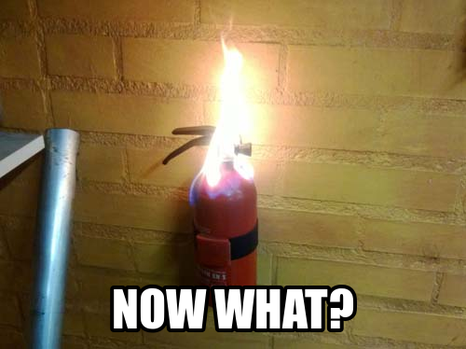
FPOM Recommendations

